Slide 1
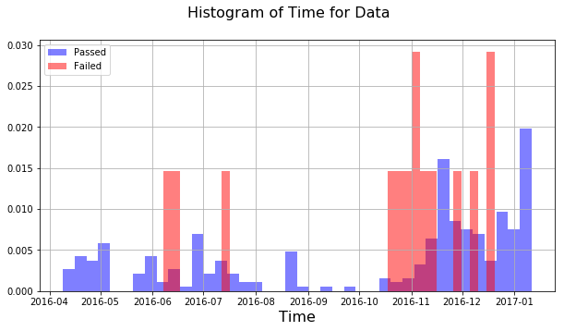
Looking at Passed/Failed Units in Time
CNR-547 < 52.5
Time <= Jan 10, 2017
This analysis for the units with SMSR2>=45
Total number of units with CNR-547 < 52.5 = 284
  Previously we had 15241 units, so, 270 passed units had CNR-547<52.5
Number of failed units → 14
  Previously we had 145 failed units, so, 14 failed units had CNR-547<52.5.

Slide 2
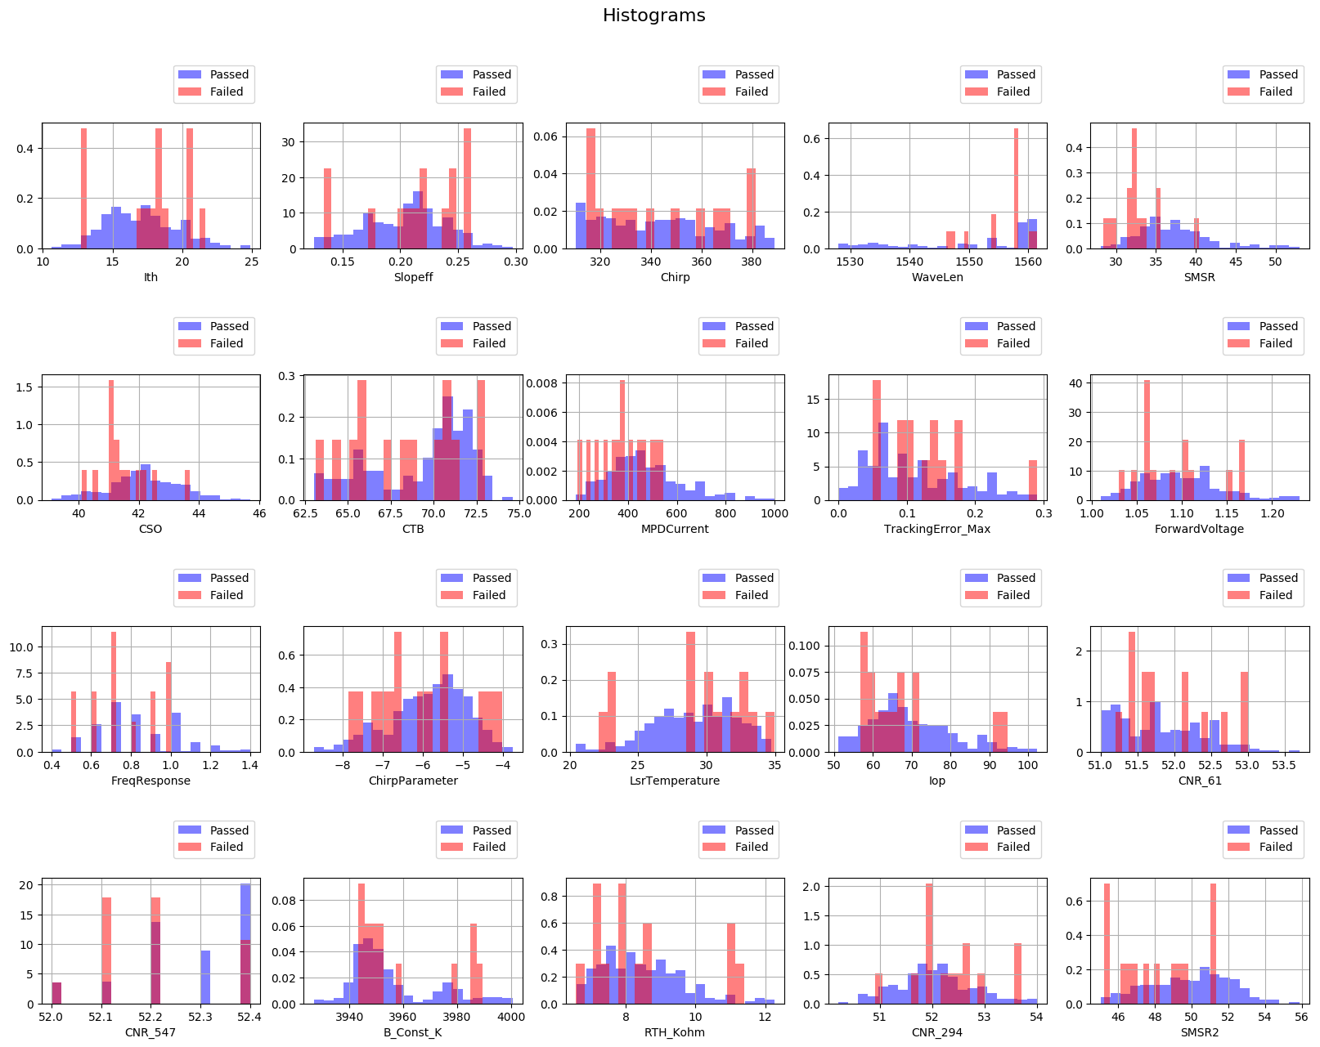
Histograms of Different Features For Units with CNR-547 < 52.5

Slide 3
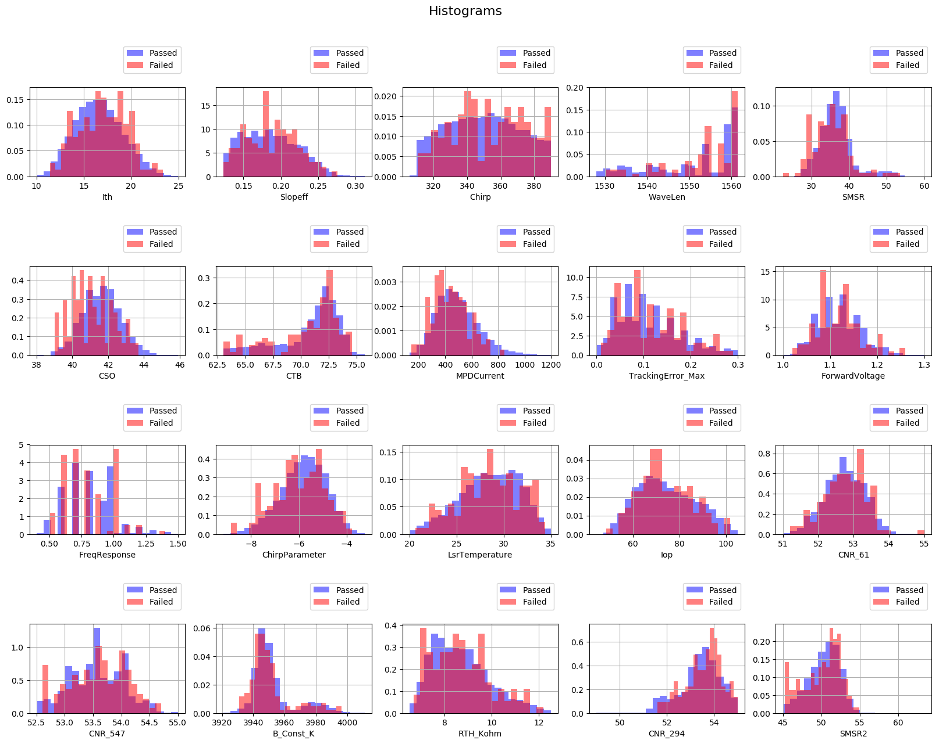
Histograms of Different Features For Units with CNR-547 >= 52.5

